Slide 1
The Blood Supply system
Info 5100: application engineering & development – FINAL PROJECT
Team members:
Kaustubh Chaudhari nuid: 001218494
Parakh Mahajan nuid: 001236045
Piyush sharma nuid: 001282198

Slide 2
INDEX
1) PROBLEM STATEMENT
2) APPROACH
3) USE CASES
4) OBJECT MODEL
5) SCREEN SHOTS

Slide 3
PROBLEM STATEMENT
Nearly 5 million people require blood transfusions each year
It is very important that blood supply and availability is maintained effectively
Our goal is to provide safe and reliable blood services to all the needful patients
Blood donors play a very major role in today’s healthcare system and this application will speed up the process of donation and attract many new blood donors

Slide 4
APPROACH
We developed a java swing application that handles overall flow of blood supply system right from donation to proper inventory management of blood products
We’ve incorporated the Ecosystem model that is highly scalable
Ecosystem model consists of:-
1) Networks
2) Enterprises
3) Organizations
4) User Roles

Slide 5
USE CASES
1) Donor management:
Donor schedules an appointment with the receptionist for blood donation
Then donor visits the blood bank to donate
2) Lab processing:
All the blood samples received from blood bank are tested and if approved are packed and forwarded to the distribution center for storage
3) Distribution management:
Blood products are stored safely in the distribution centers.
Distribution centers receive requests from hospitals

Slide 6
USE CASES
4) Hospital requests:
Doctor send requests to pharmacist
Pharmacist then forward the requests to Blood bank's inventory
5) Data analytics
Admin can view data patterns pertaining to donor’s information, health, gender
Analysis on the basis of donor’s age.
Inventory can view data patterns on blood donated.
Hospital Enterprise can view patterns of blood demand.

Slide 7
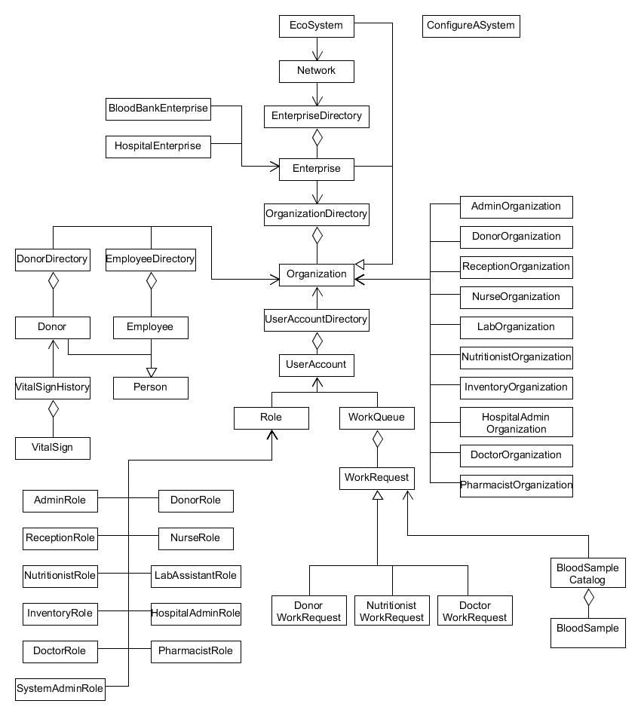
OBJECT MODEL

Slide 8
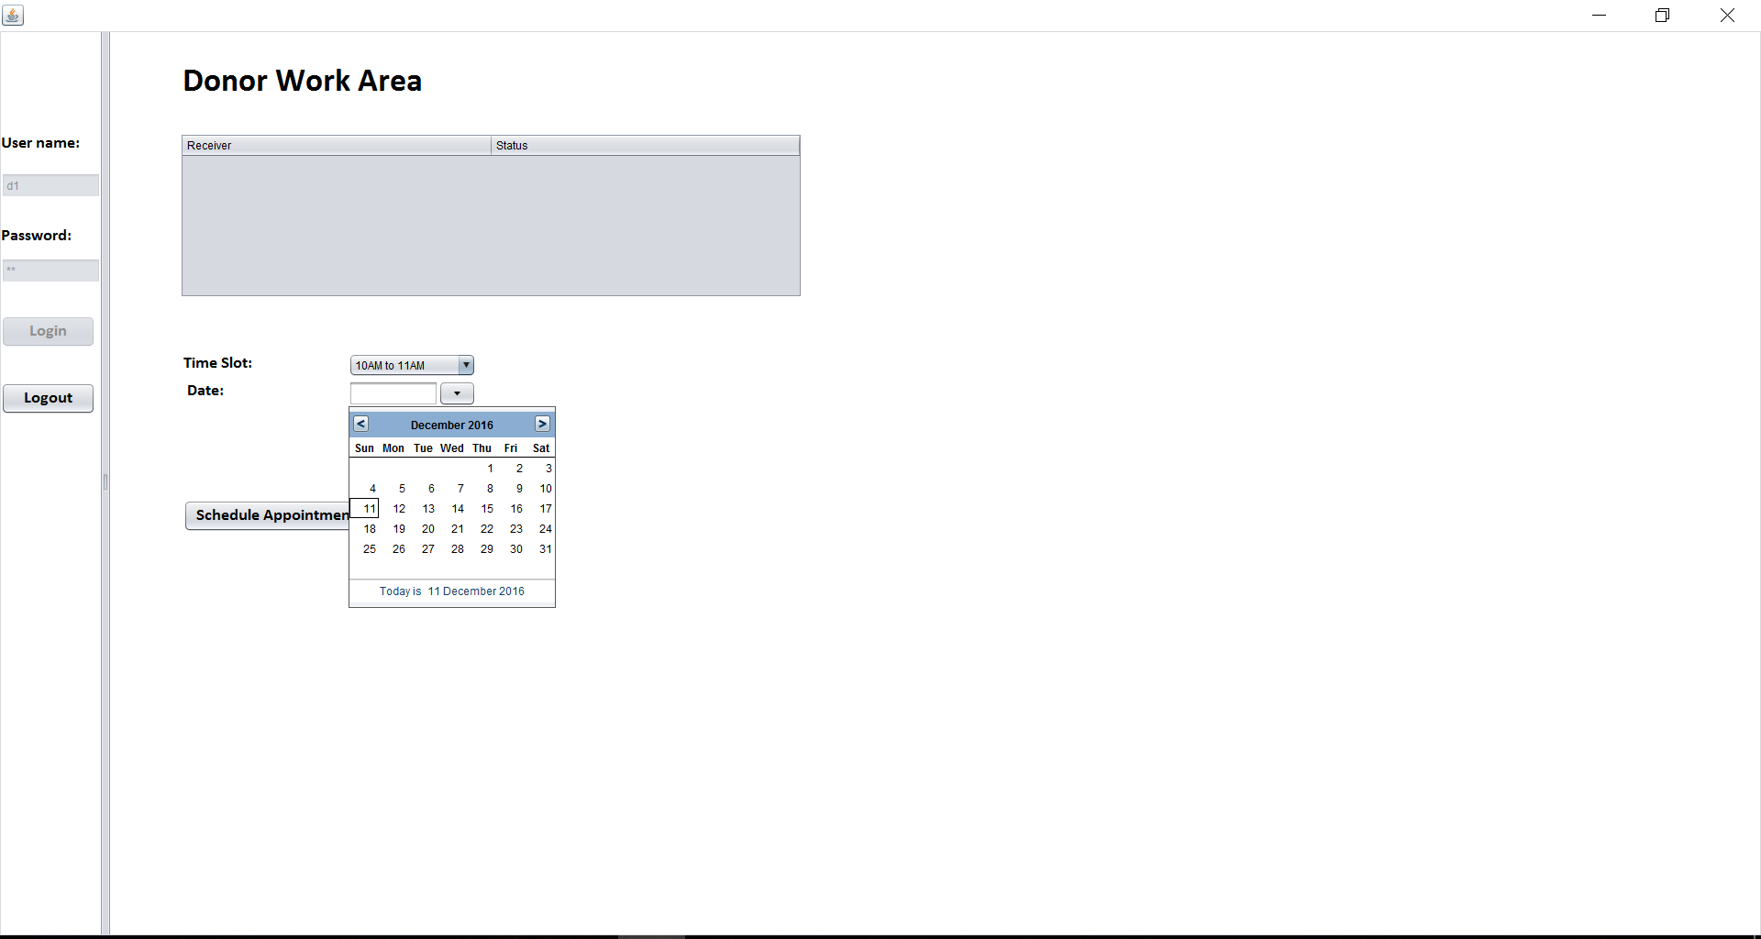
WORKFLOW 1 SCREEN SHOTS

Slide 9
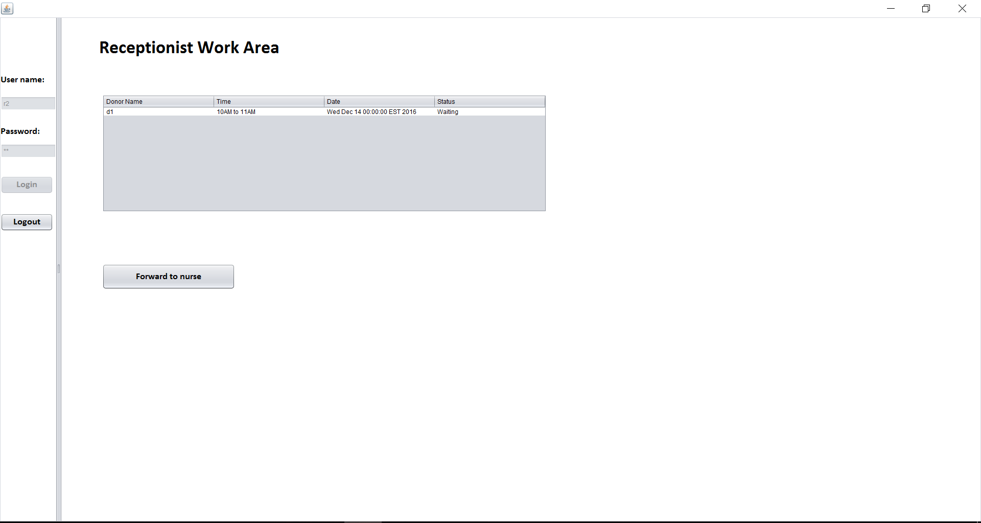

Slide 10
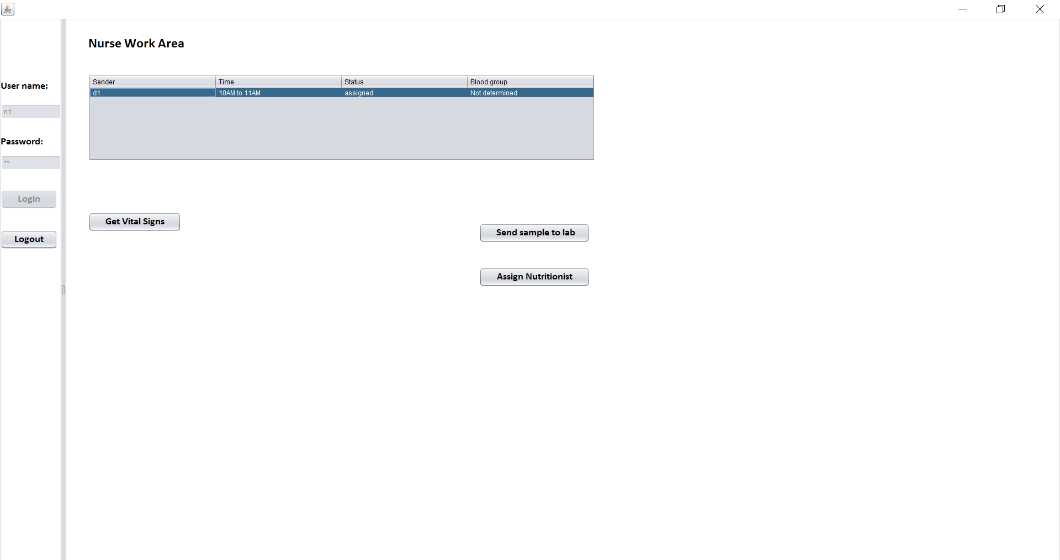

Slide 11
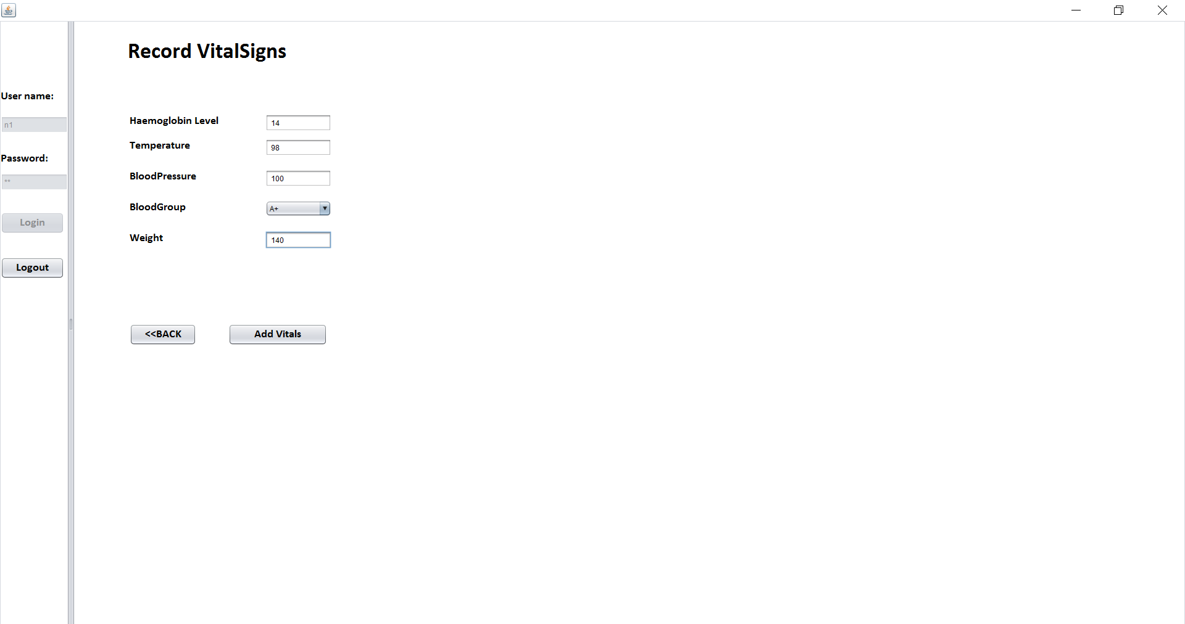

Slide 12
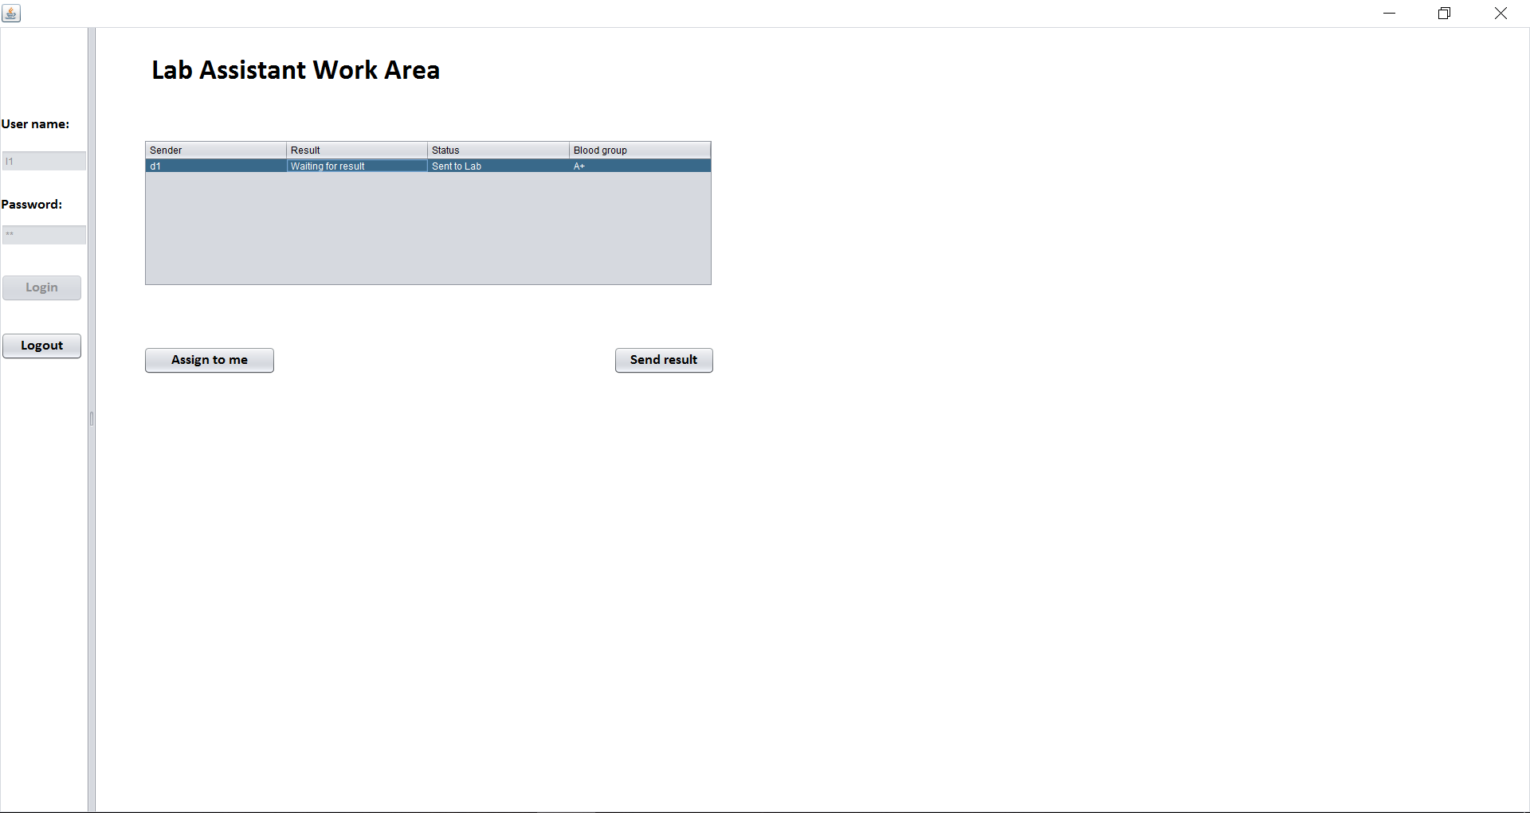

Slide 13
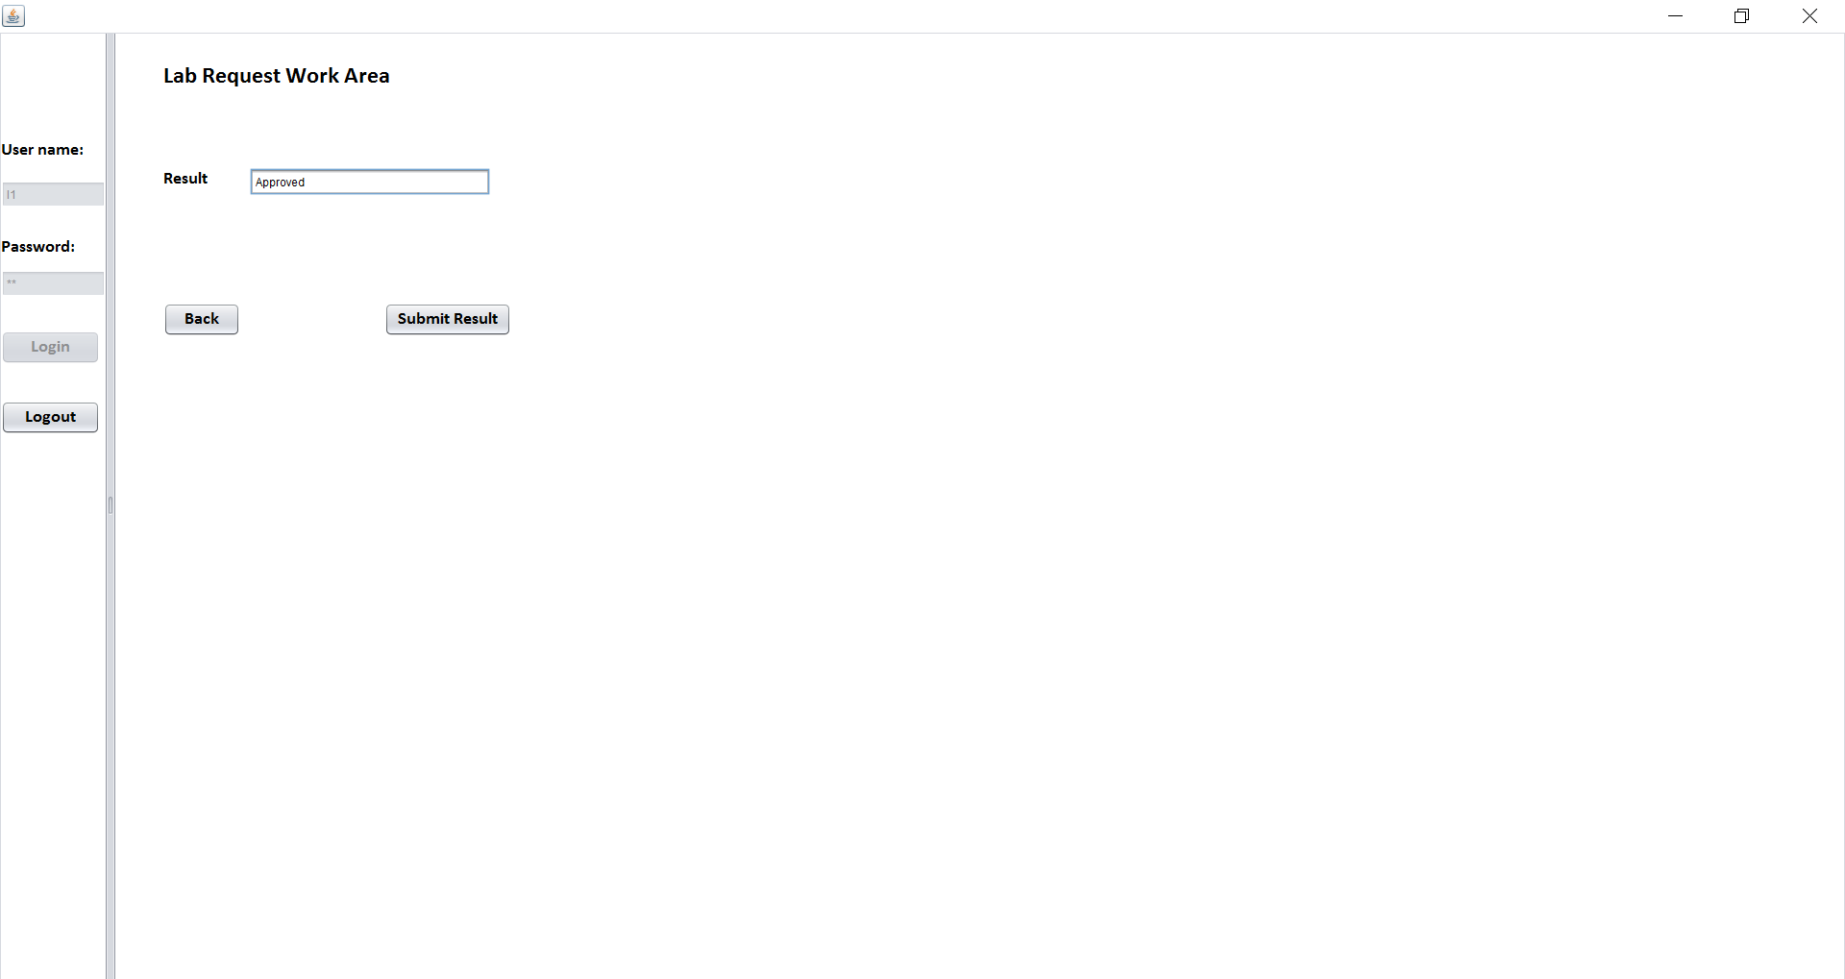

Slide 14
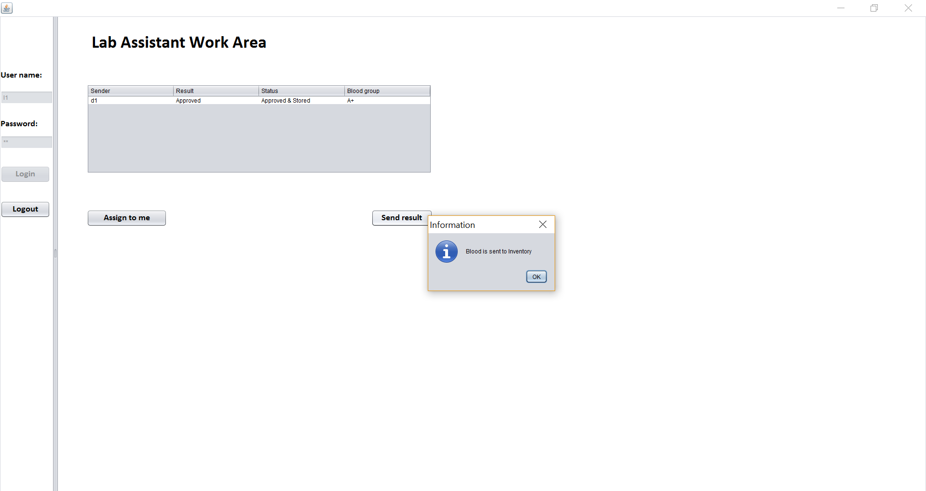

Slide 15
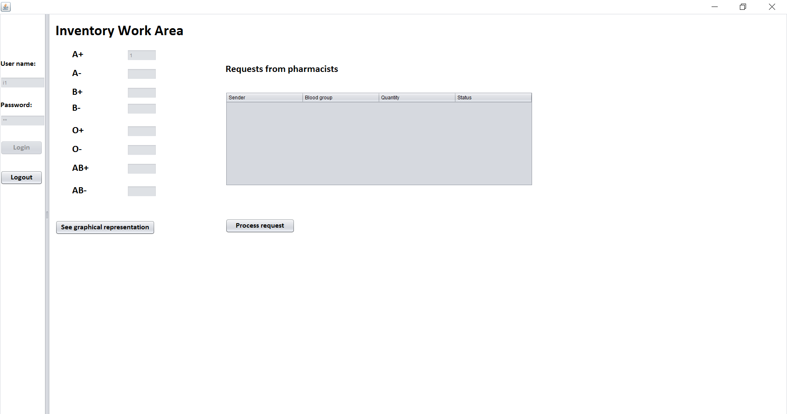

Slide 16
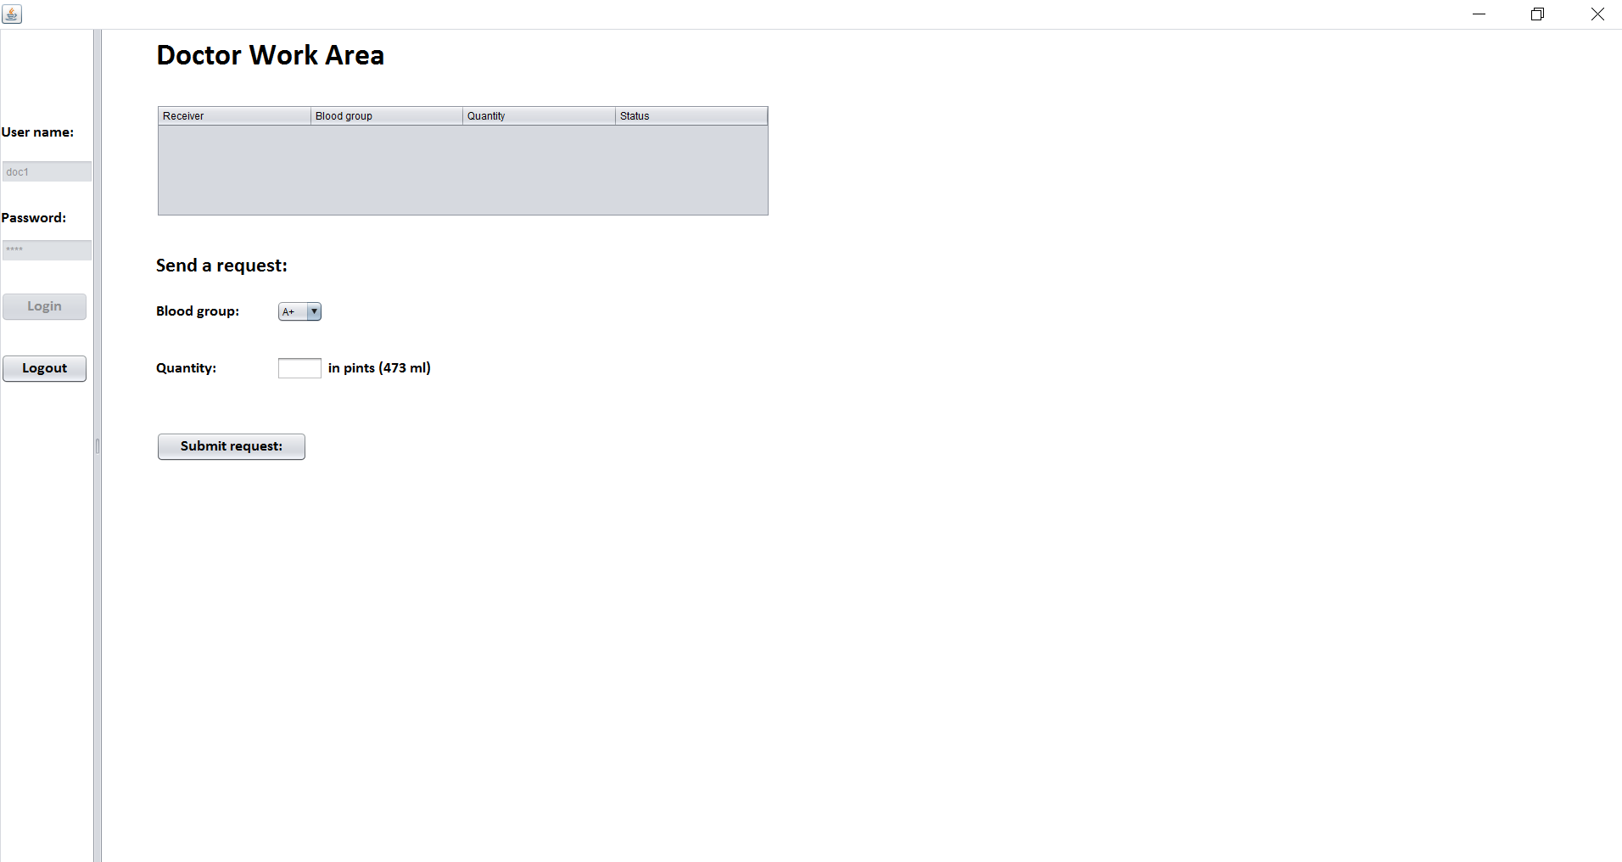
WORKFLOW 2 SCREENSHOTS

Slide 17
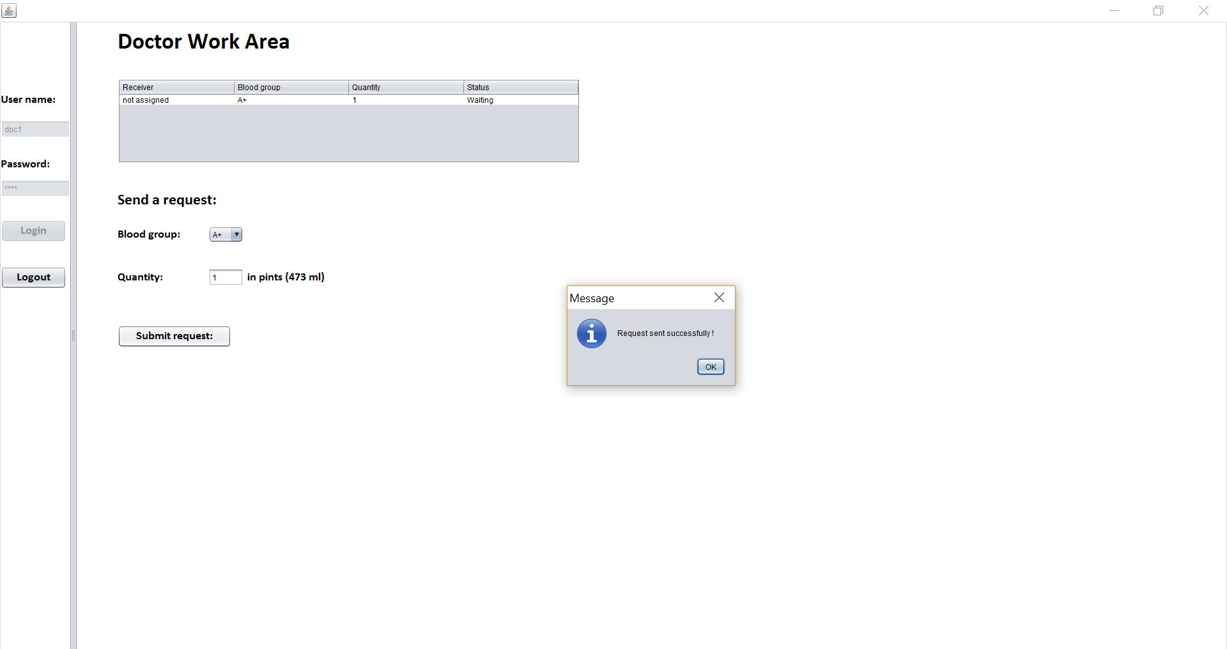

Slide 18
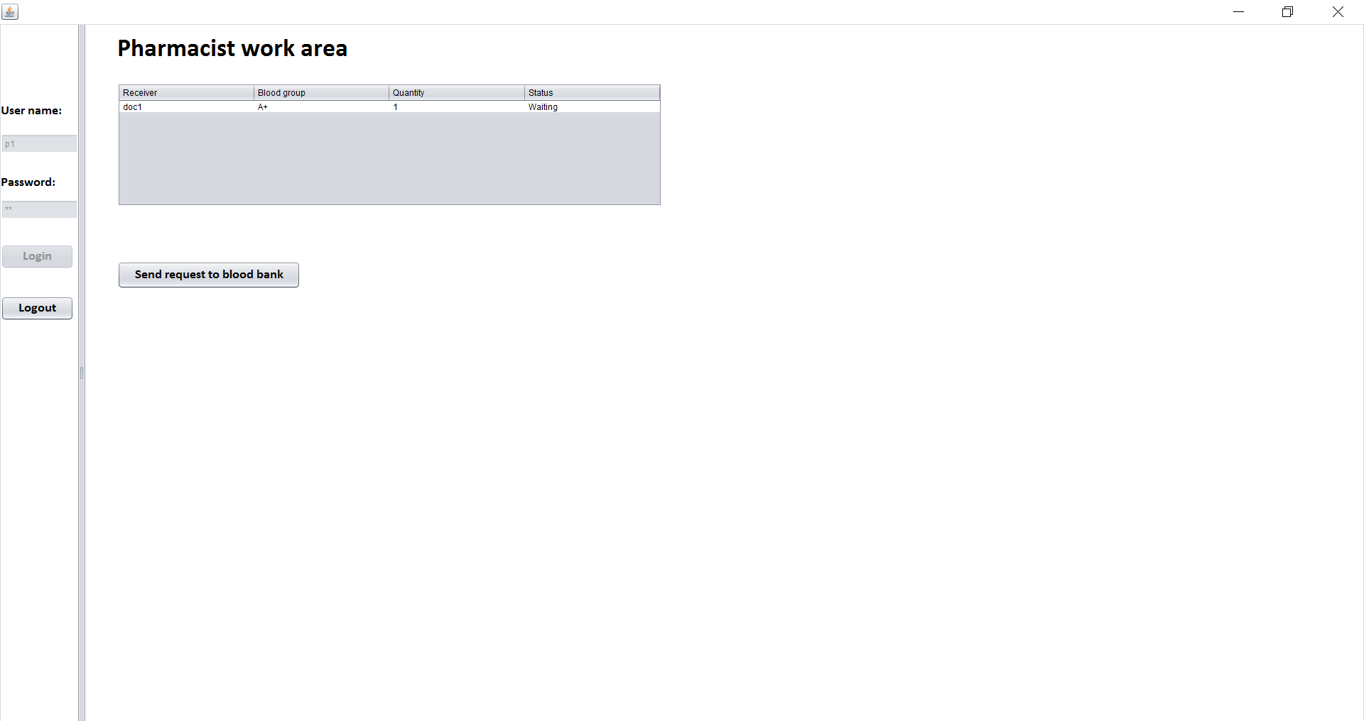

Slide 19
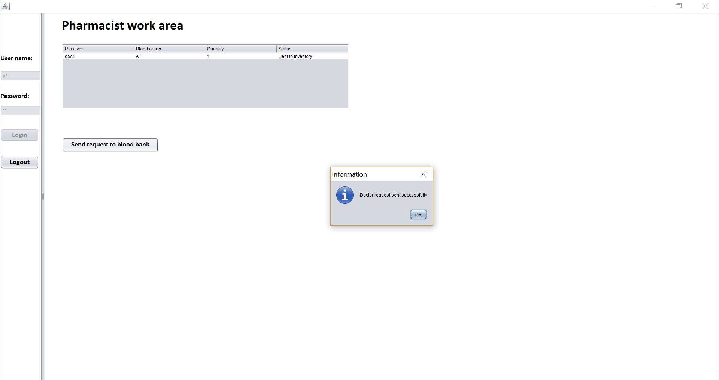

Slide 20
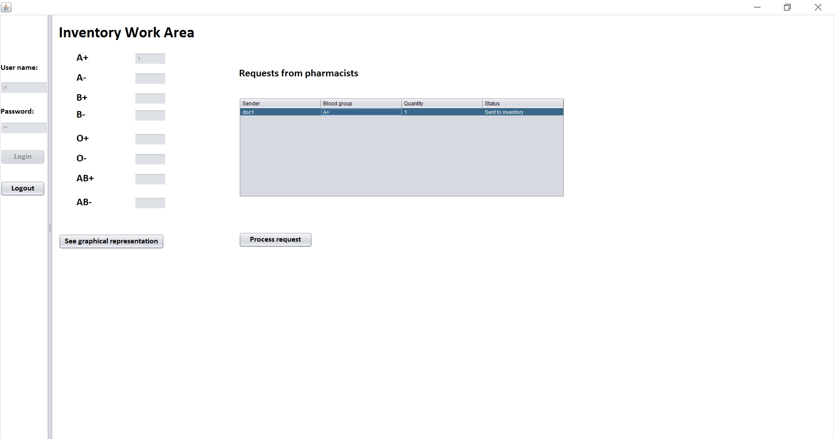

Slide 21
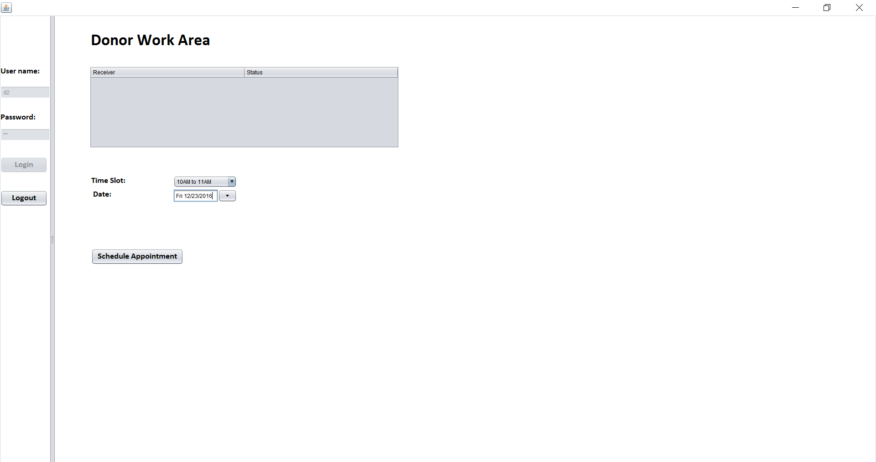
WORKFLOW 3 SCREENSHOTS

Slide 22


Slide 23
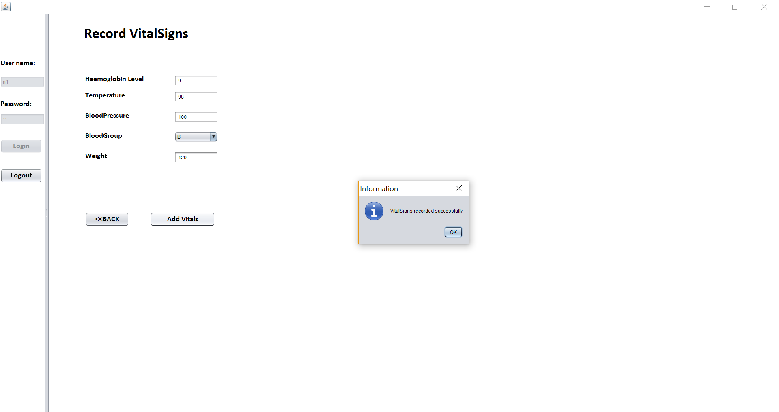

Slide 24
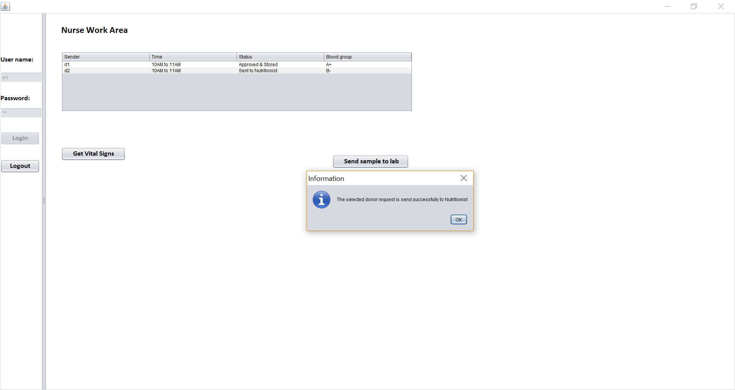

Slide 25
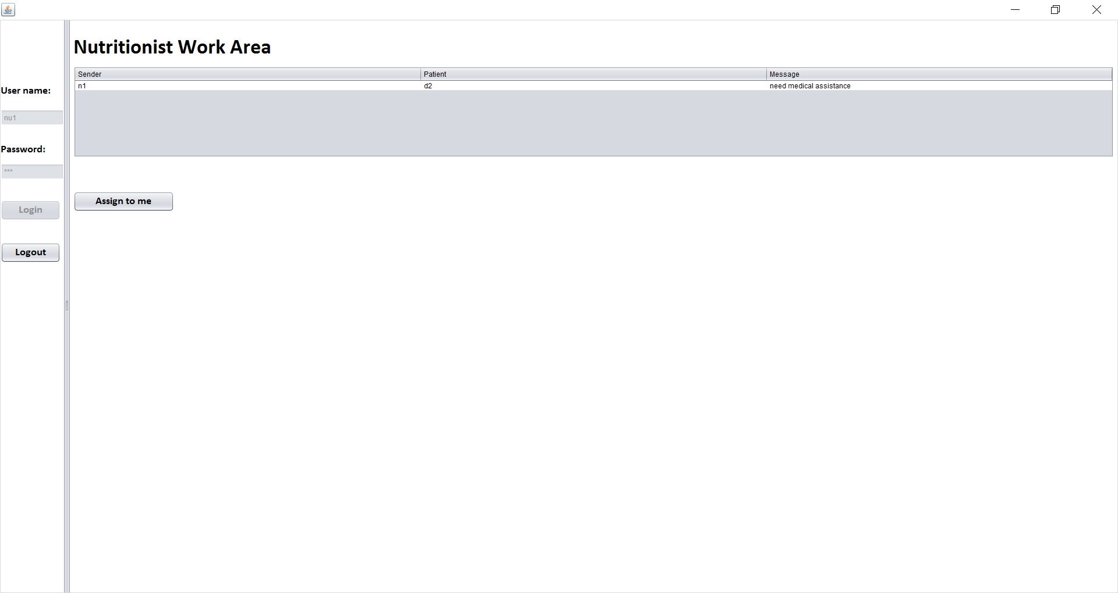

Slide 26
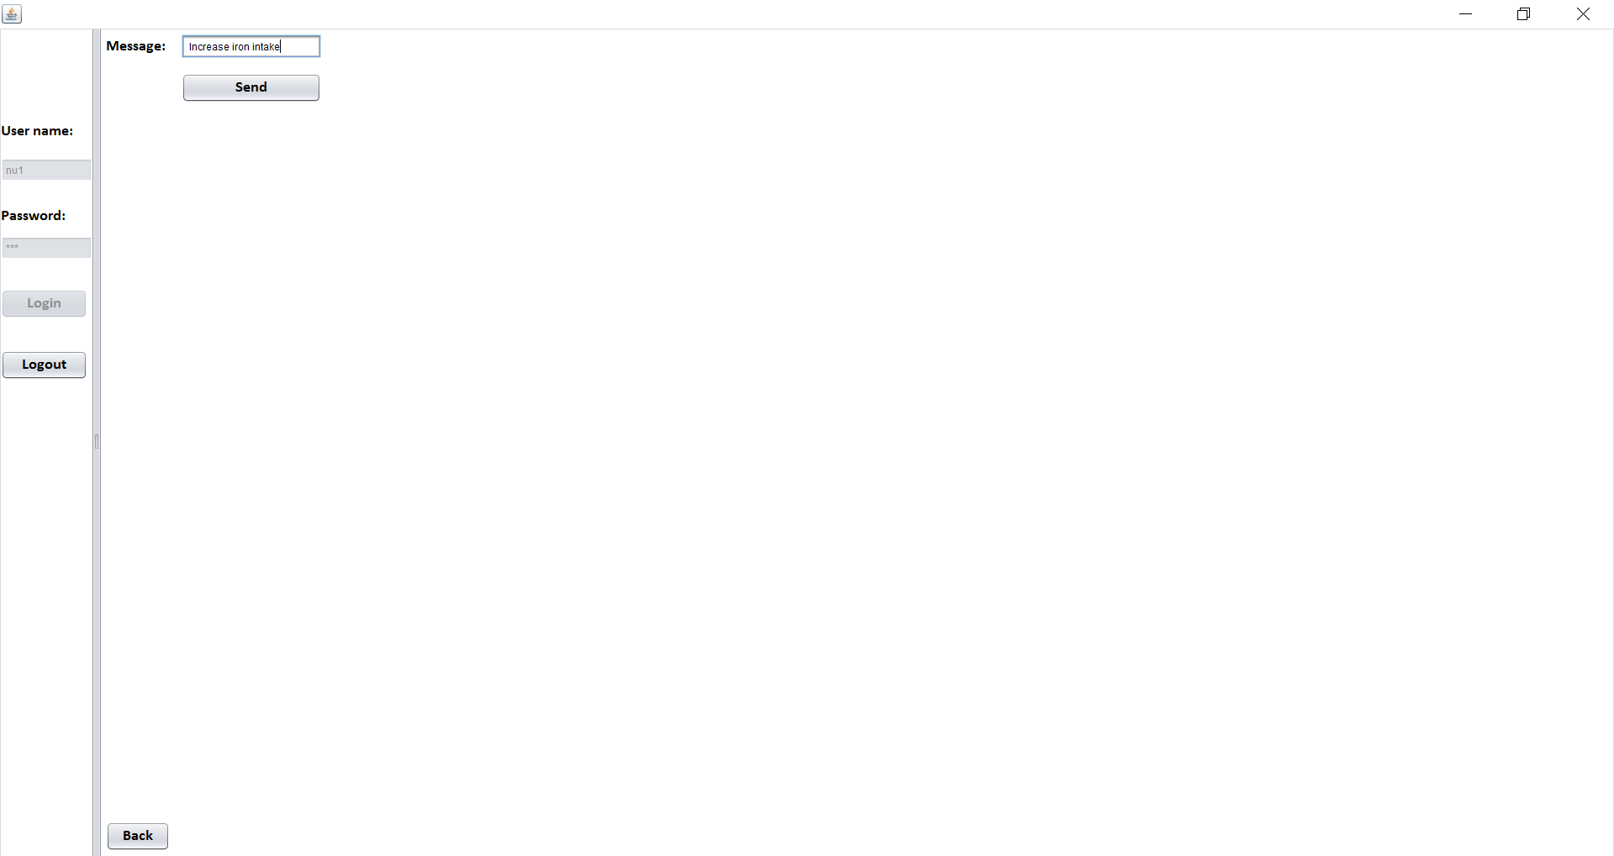

Slide 27
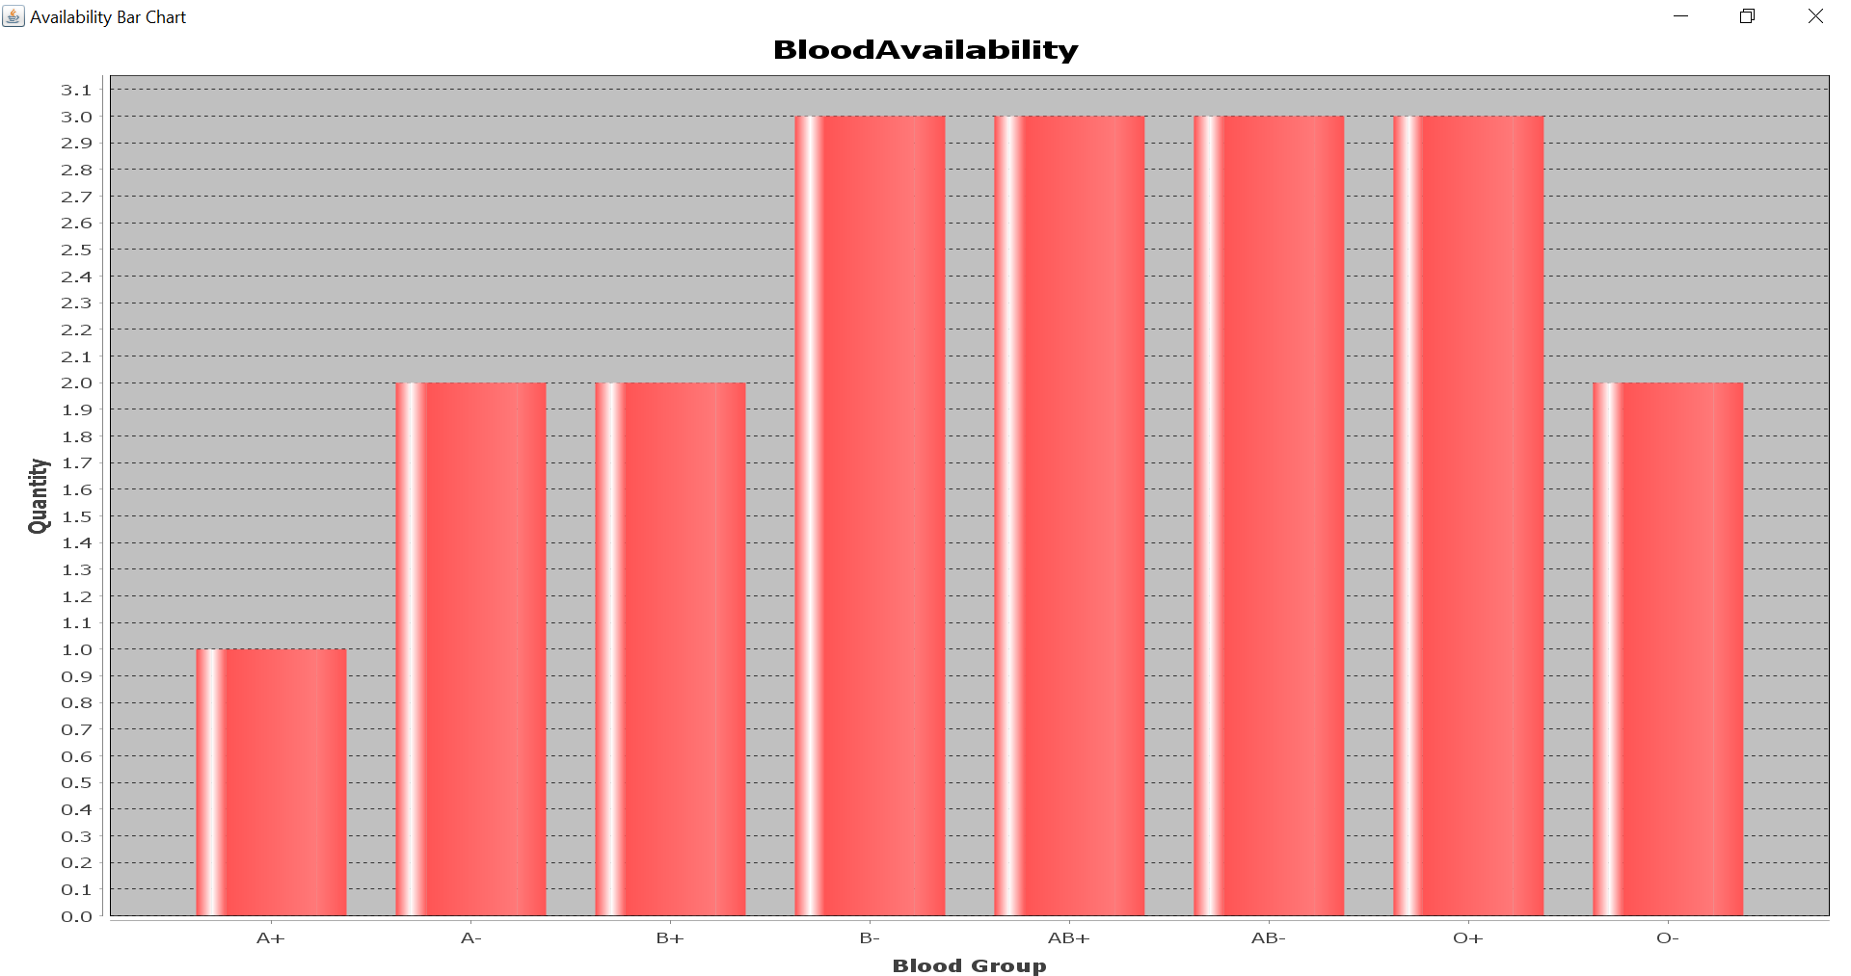
WORKFLOW4 SCREENSHOT

Slide 28
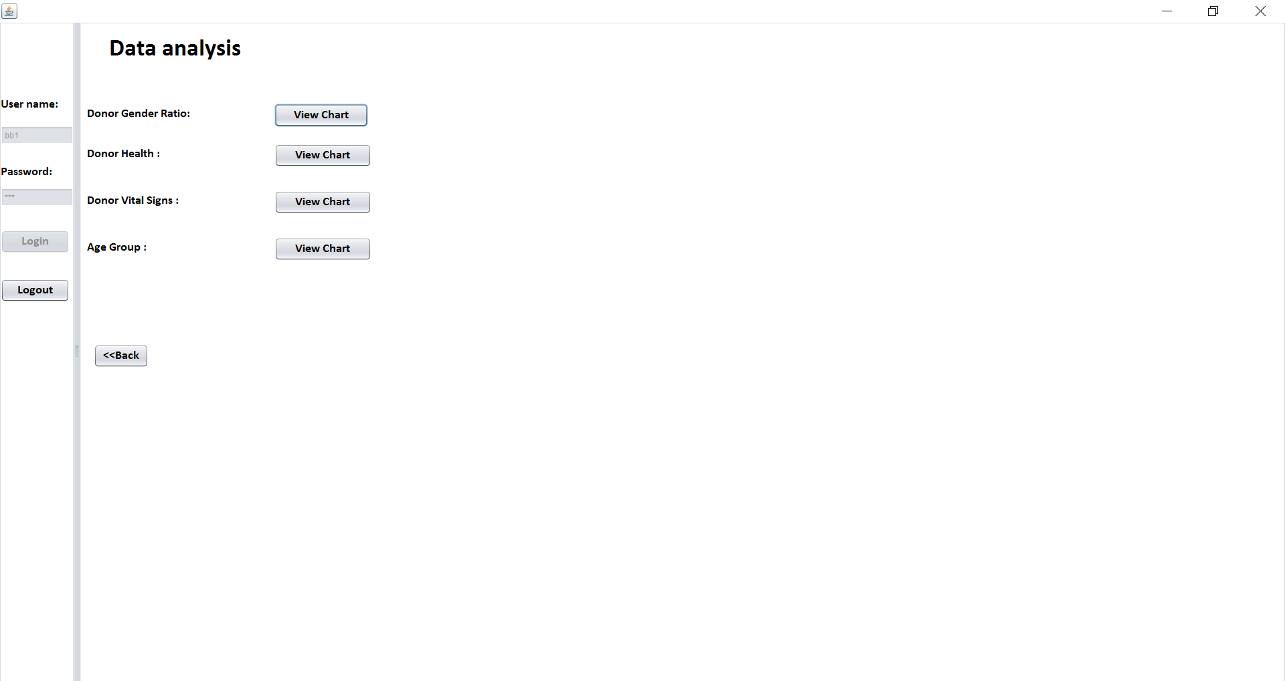

Slide 29
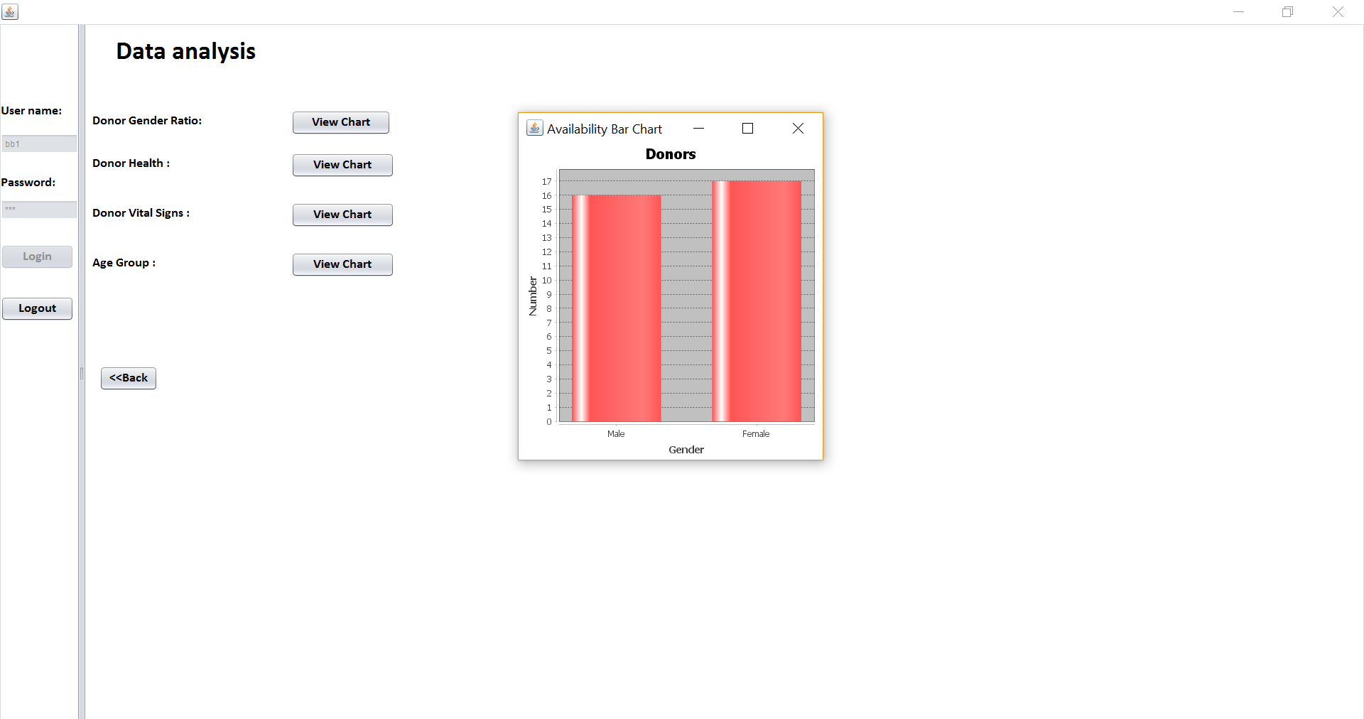

Slide 30
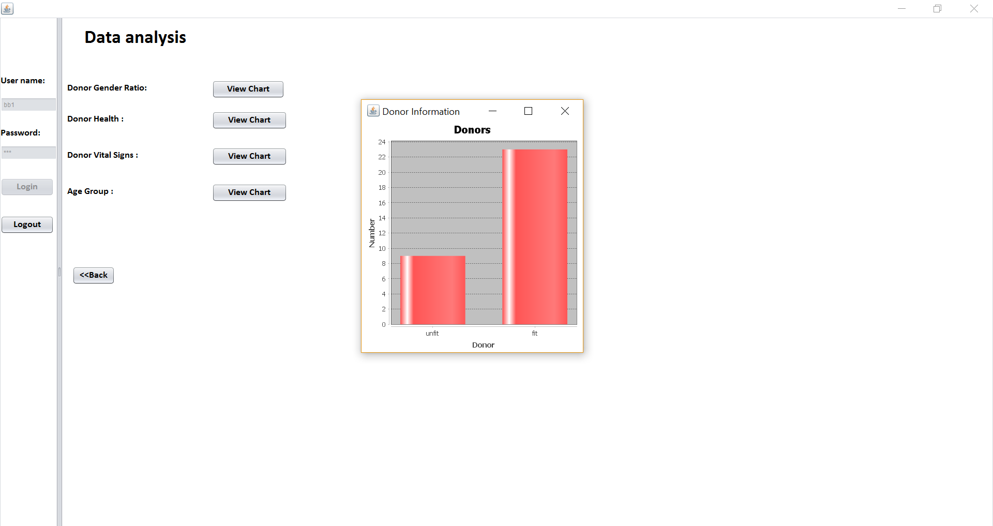

Slide 31
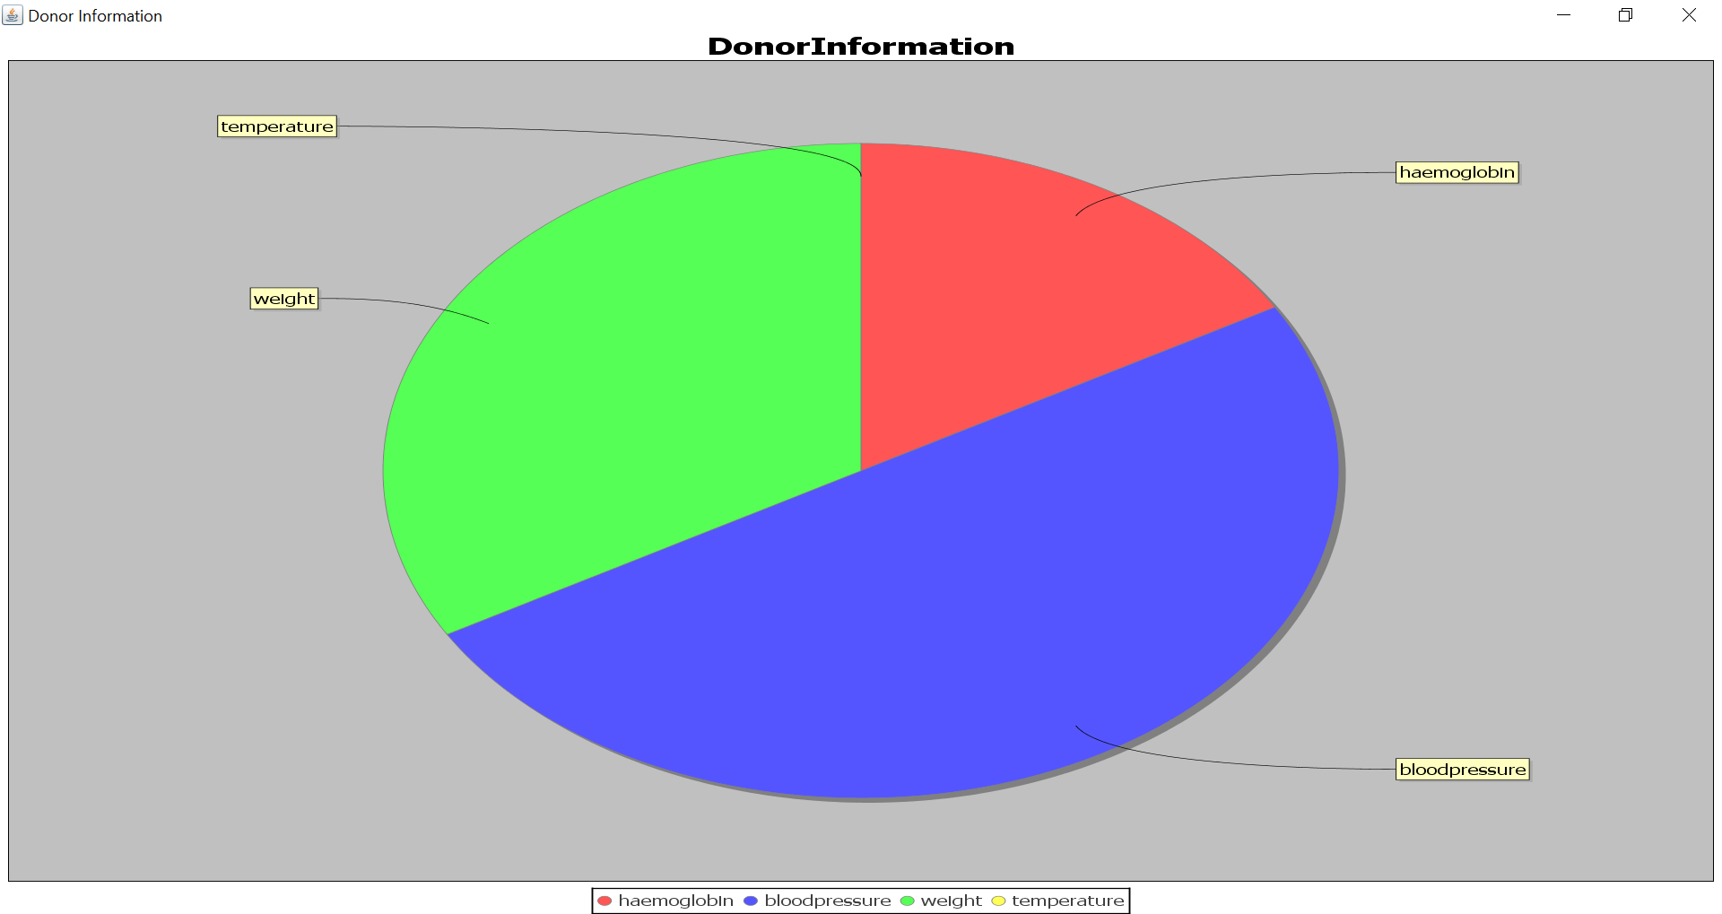

Slide 32
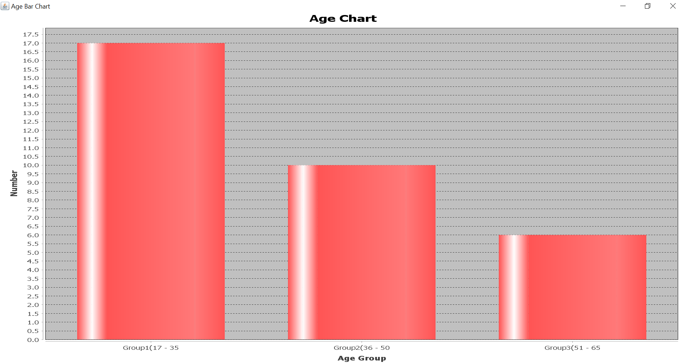

Slide 33
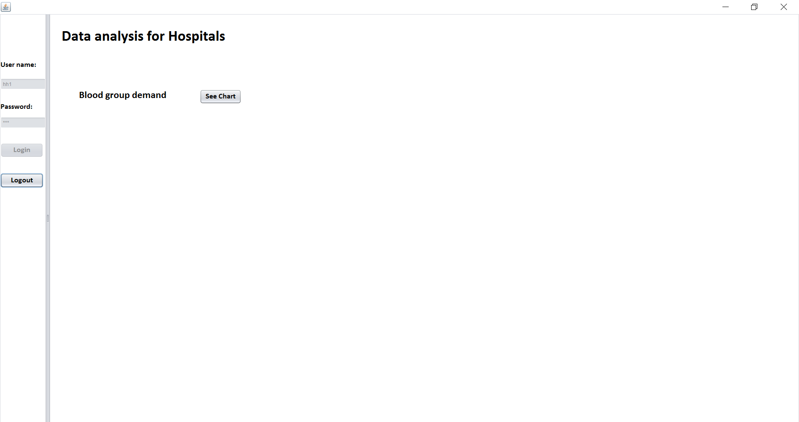

Slide 34
